Slide 1
Membership Analysis
Author: Pandu Gumelar Pratama
Date of Creation:November 2022

Slide 2
Index
What we will be discuss in this presentation
Problem Identification
Data Gathering and Transformation
Findings
How we can improve the numbers

Slide 3
Problem Identification
Key Problem: How to improve the number of annual membership
Analysis:
The membership types :
Casual : People who bought single ride pass or full day pass
Cyclistic: People who bought Annual Pass
What to analyze :
Casual vs Cyclistic riding patterns over time

Slide 4
Data Gathering and Transformation
Source of data: Data gathered from internal data from Q2 2019 to Q1 2020 (link to resource)
From the data we collected we transform to ready to analyse data by
Cleaning the inaccuracy (end date < start date)
Blank data
Transform to single data file (from Quarter basis to Year Basis)

Slide 5
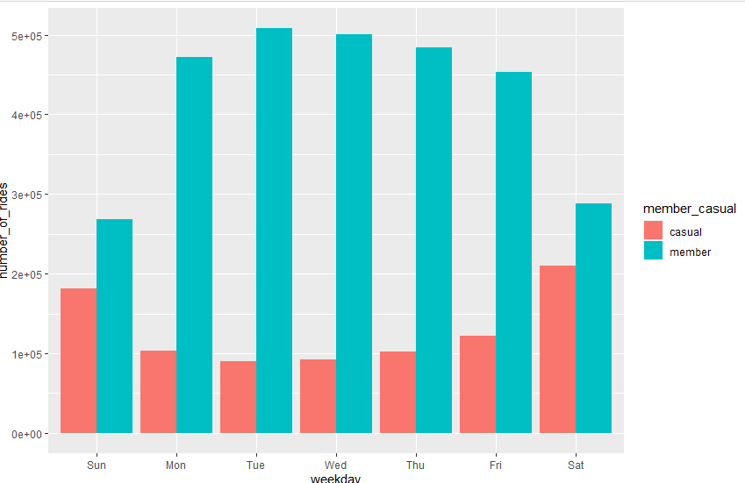
Findings (1/3)
Current membership status shows that cyclistic have higher number of rides compared to casual

Slide 6
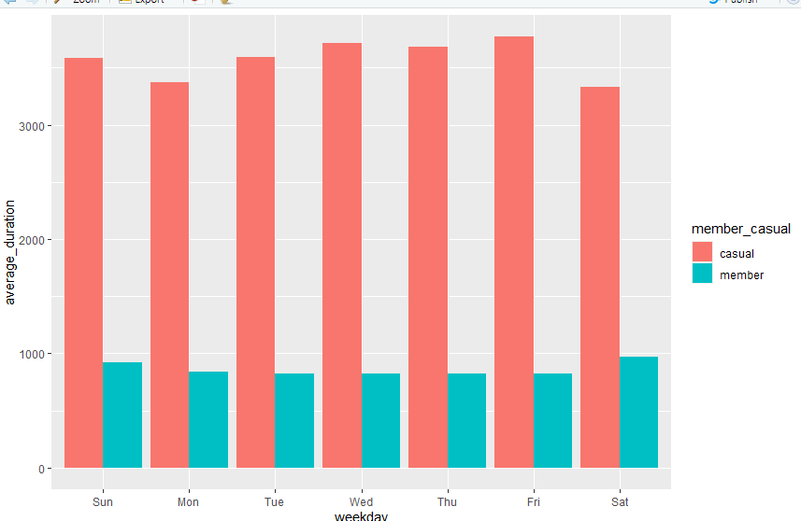
Findings (2/3)
But while total number of rides from casual is lower than Cyclistic, the average duration trip from casual is significantly higher than Cyclistic. This may create opportunity to offer annual membership to casual membership.

Slide 7
Findings (3/3)
From all the casual member rides, most of them starts at Streeter Dr & Grand Ave

Slide 8
How we can improve the numbers?
Strategy:
Offer membership that have duration of the rides higher than average
Average casual rides duration: 59,2 minutes
Placing advertisement from most populated start station
Most populated start station Streeter Dr & Grand Ave

